Slide 1
COIN TRACK
Personal expense tracker

Slide 2
APP OVERVIEW
Features:
Authentication
Transactions Recording
Transactions Summary

Slide 3
FEATURES
Authentication
Transaction Recording
Transaction Summary
Sign up
Email Verification
Sign in
Add New Transaction
Income or Expense
Category
Description
Amount
Date
Delete Transaction
Filter Drop Down Button
Expense Summary (Pie chart)
Income Summary (Bar chart)
Time Lapse (Line chart)

Slide 4
TECH STACK
Front End
Back End
Flutter :
Google’s open-source technology for creating mobile, desktop, and web apps with a single codebase.
Dart:
Object-oriented client-optimized programming language used to build mobile and web applications on various platforms.
Firebase:
Set of backend cloud computing services and application development platforms provided by Google.
Firebase Authentication
Firestore Database
Hosting

Slide 5
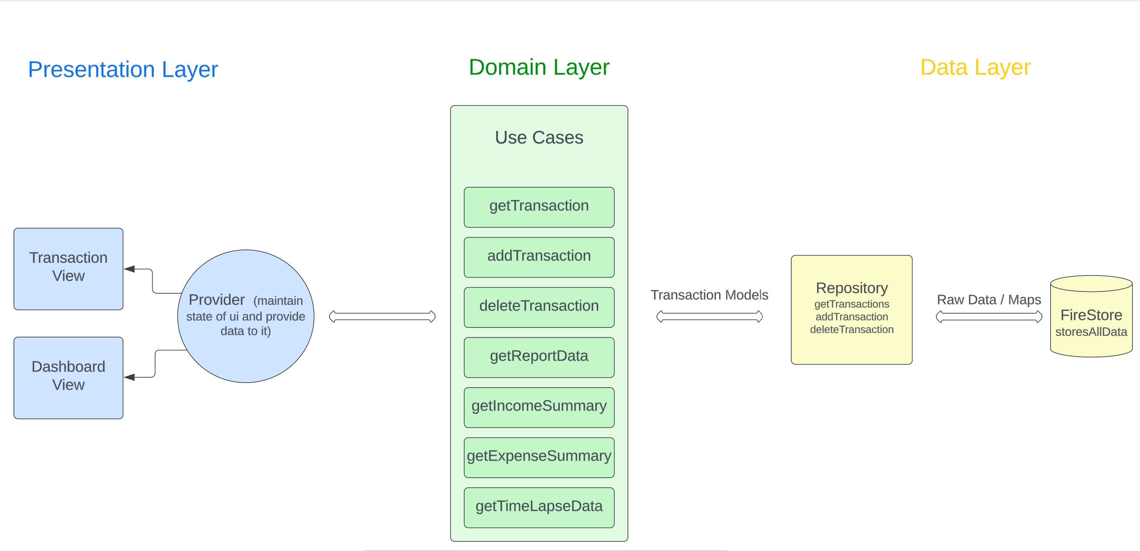
ARCHITECTURAL OVERVIEW

Slide 6
RESPONSIVENESS
Mobile View
Web View
Tablet View

Slide 7
Dependencies
Flutter sdk
Firebase plugins
Provider
Get it
Fl chart
Intl

Slide 8
Thank You
Feel free to ask any Question!.

